Slide 1

Machine Learning Stock Prediction
Jack Harvey, Adib Khan, Mostafa Moamen, Shawn Cavalieri

Slide 2
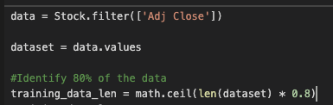
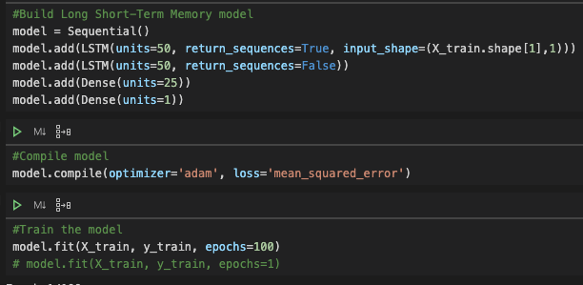
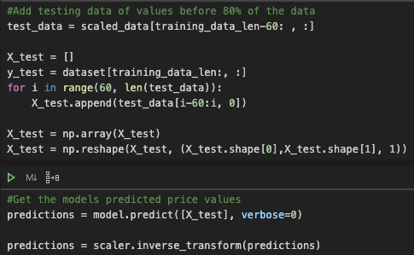
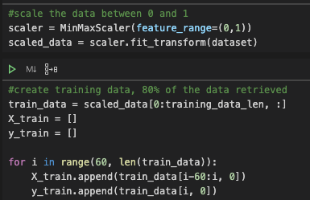
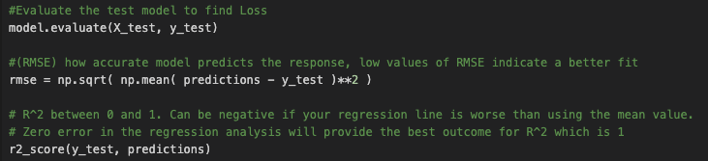
Long Short-Term Memory Network
A recurrent neutral network used to recognize sequential characteristics and use patterns to predict the next stock price.
Gather prices from 2018 to today. Identify 80% of the dataset to train the model.
Convert X and y train to NumPy arrays

Slide 3
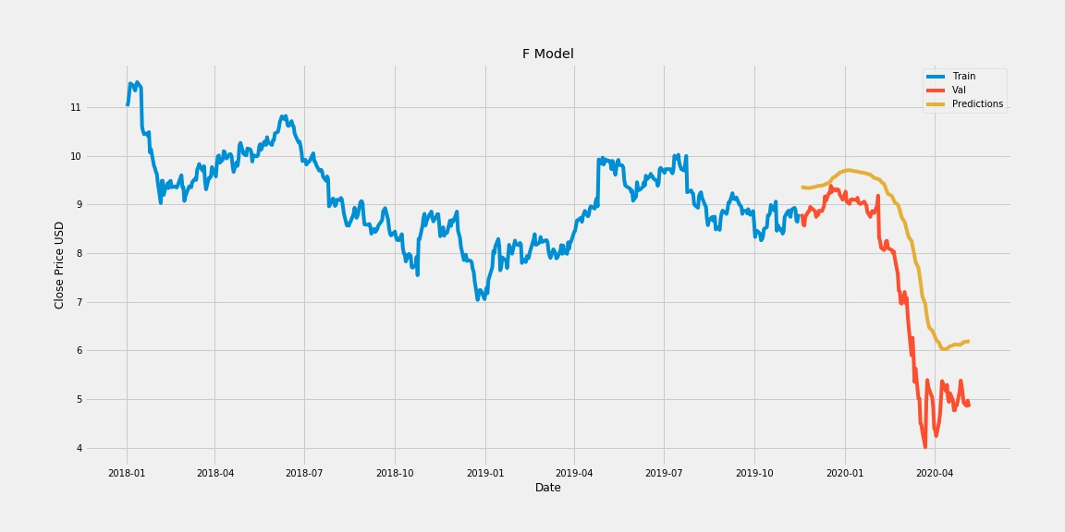

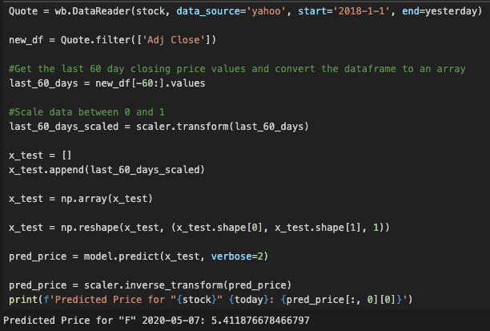
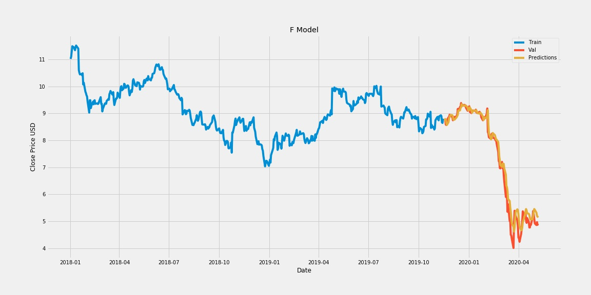
Ford
Predicted Price 2020-05-07: 6.179
Predicted Price 2020-05-07: 5.411
Actual Closing price 2020-05-07: 4.91
Actual Closing price 2020-05-07: 4.91
Predicted Price for 2020-05-08: 6.174
Predicted Price for 2020-05-08: 5.39
Train Data on 1 Epoch
Train Data on 50 Epochs
Loss = 48 | RMSE = 0.1-1 | R^2 = 0.53
Loss = 49.12 | RMSE = 0.246 | R^2 = 0.932
Train Data on 100 Epochs
Loss = 49
RMSE = 0.13
R^2 = 0.97
Predicted Price 2020-05-07: 5.138
Actual Closing price 2020-05-07: 4.91
Predicted Price for 2020-05-08: 5.132
Notes:
55

Slide 4
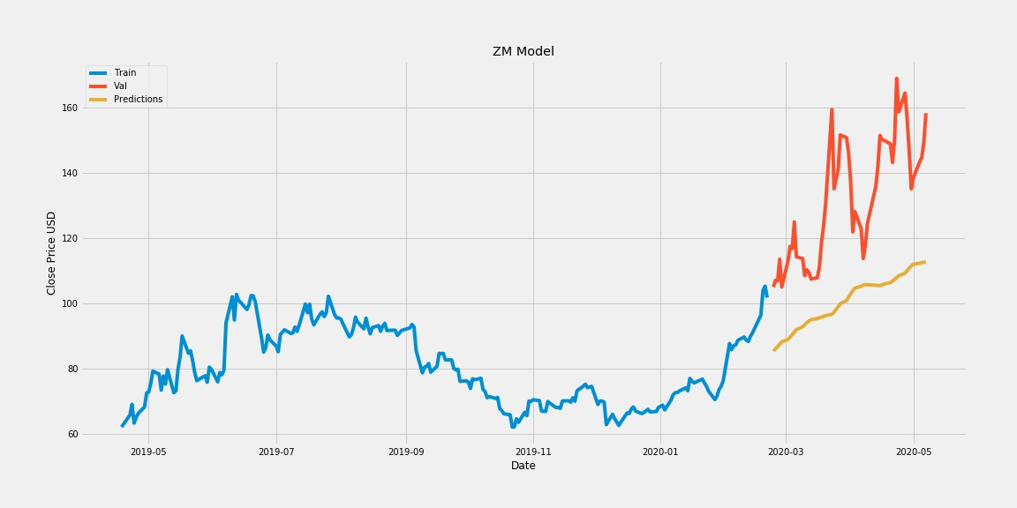
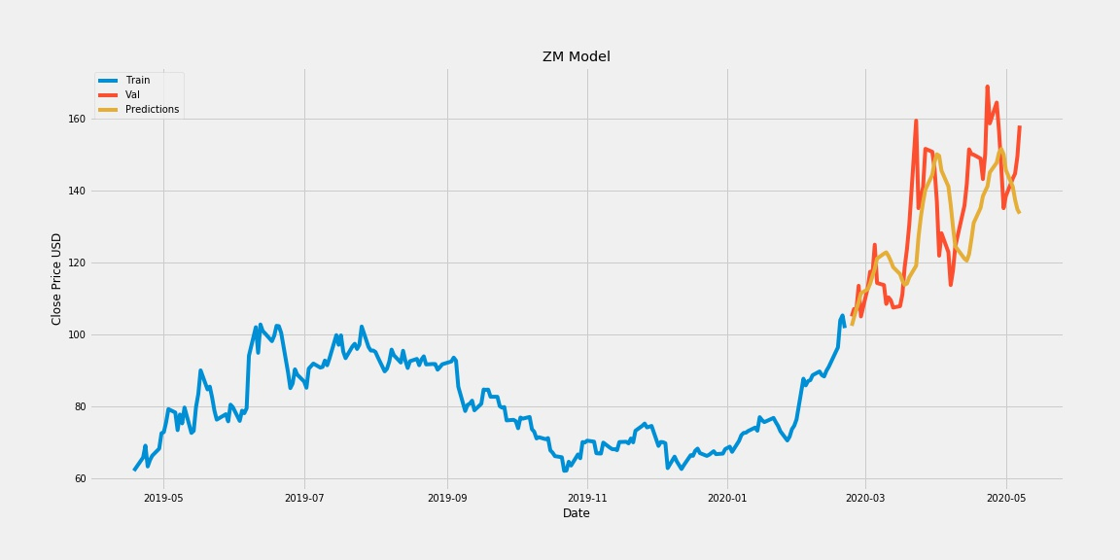

Zoom
Predicted Price 2020-05-07: 139.98
Predicted Price 2020-05-07: 133.66
Actual Closing price 2020-05-07: 159.19
Actual Closing price 2020-05-07: 159.19
Predicted Price for 2020-05-08: 140.40
Predicted Price for 2020-05-07: 134.58
Train Data on 1 Epoch
Train Data on 50 Epochs
Loss = 17,645.49 | RMSE = 31.34 | R^2 = -2.46
Loss = 17,573.19 | RMSE = 2,878 | R^2 = 0.4
Train Data on 100 Epochs
Loss = 17,557.397
RMSE = 3.647
R^2 = 0.72
Predicted Price 2020-05-07: 157.06
Actual Closing price 2020-05-07: 159.30
Predicted Price for 2020-05-08: 163.71

Slide 5
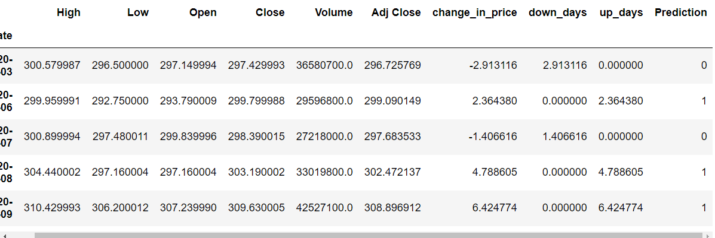
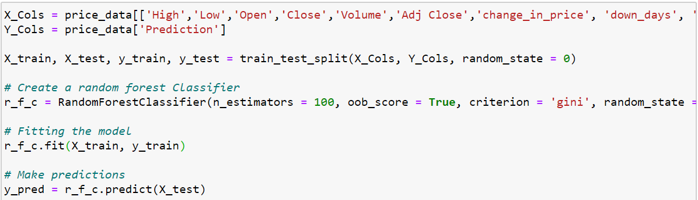
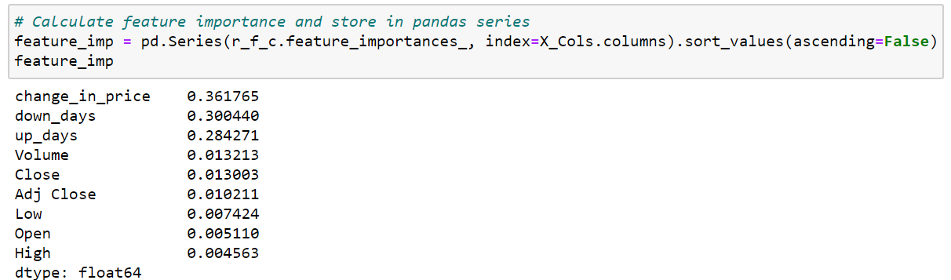
Random Forest – Model Details
Stock Used and Dates: Apple from 1/1/20 to 5/1/20
Added 4 new columns: ‘change_in_price’, ‘down_days’, ‘up_days’ and ‘Prediction’ – Based on prev. day close.
For ‘Prediction’: Looking to see the trend from prev. day
0 → Negative Down Day , 1 → Positive Up Day
Dropped NaN and split data into training and testing.
Create RandomForestClassifier, fit the model, and predict using X_test
Accuracy → number of accurate predictions model made on the test set. 95% is really good.
Just looking for direction of price trend. Not by how much price increased/decreased
Feature Importance → most import. features to explain most of model

Slide 6
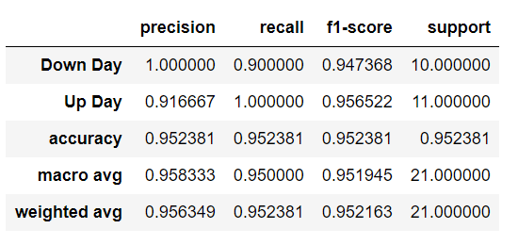
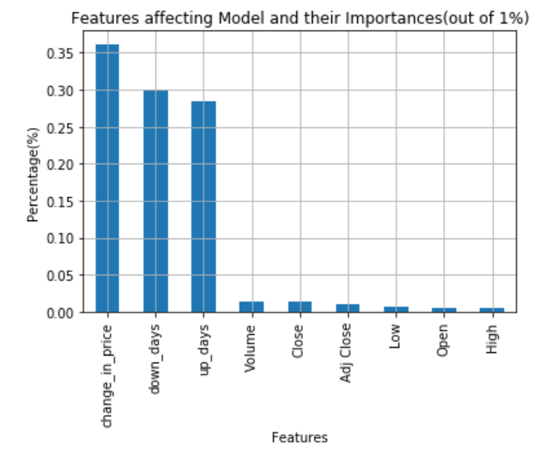
Random Forest - Model Findings
Classification Report metric evaluates model performance.
Accuracy – measures portion of all testing samples classified correctly.
**Precision → model was 100% correctly able to identify a negative down day
**Precision→ model was 91.6% correctly able to identify a positive up day.
Important Features and their percentages
Most important feature was ‘change_in_price’ column in affecting the model performance.
Least important feature was the ‘High’ column in affecting the model performance.
Able to draw conclusions about what features contribute most to the decision making in the model and help us better understand the drivers behind the model.

Slide 7
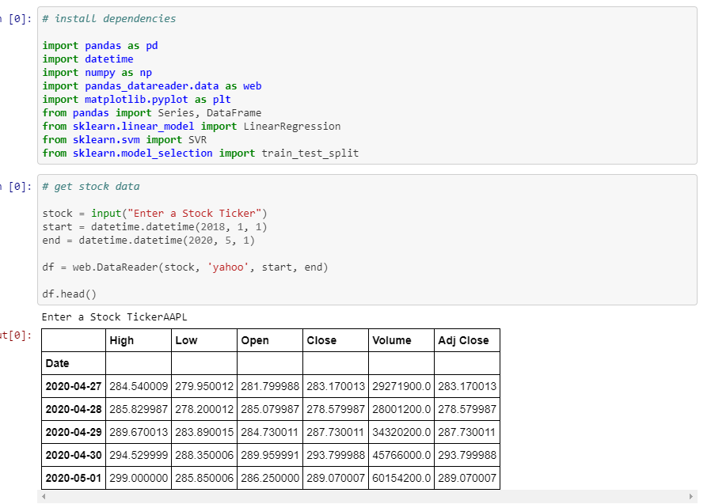
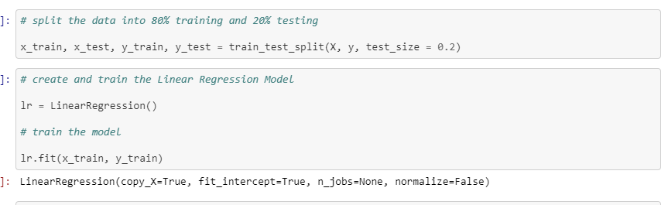
LINEAR Regression
Linear Regression
Formula to predict a dependent variable (y) based on an independent variable (X) that determines the linear relationship between the two
Used Apple stock between 1/1/18 and 5/1/20, but user can enter any stock ticker
Wanted to determine stock price prediction for “n” number of days using variable “forecast_out”
Created independent (X) and dependent (y) datasets and converted to NumPy Arrays
Trained and Tested model based on 80% training, 20% testing

Slide 8
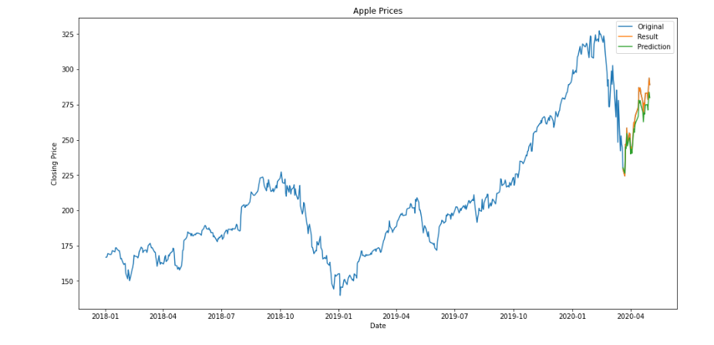
LINEAR Regression
Results
Based on a prediction length of 30 days, the linear regression produced an R^2 value of 0.72, meaning that about 72% of the variance in the dependent variable (y) is predictable based on the independent variable (X)
This number got more accurate when the prediction length was shorter, and less accurate when the prediction length was longer
The graph displays the original dataset in Blue, the predicted values based on the model in Green, and the actual results for the time period in Orange
Compared to the model results, the actual results over-performed

Slide 9
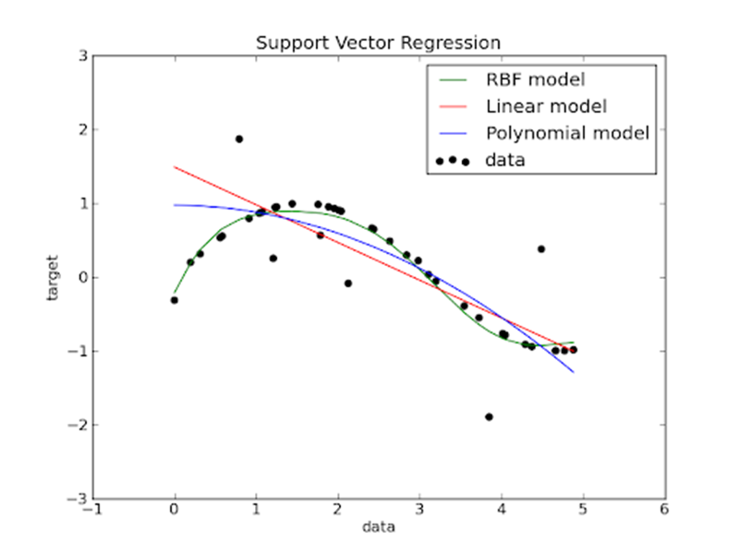
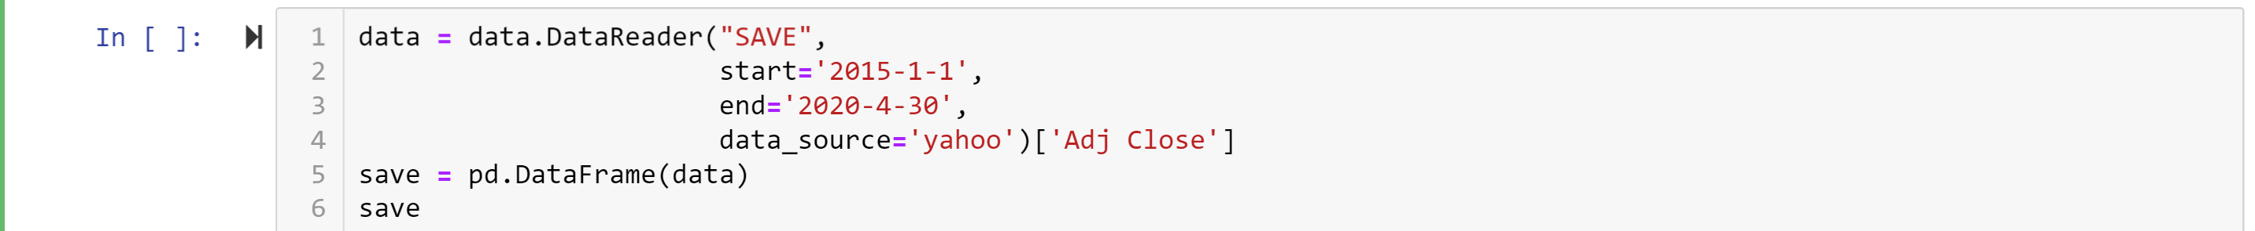
Support Vector Regression (SVR)
What is a Support Vector Regressor?
A type of regressor that is similar to Linear Regression
Difference between them is that you can put a Non-Linear Regression in the kernel
In the Kernel we used the Radial Basis Function (RBF)
Pulling the Data
Pandas DataReader to get data from Yahoo Finance
Transform data into a DataFrame

Slide 10
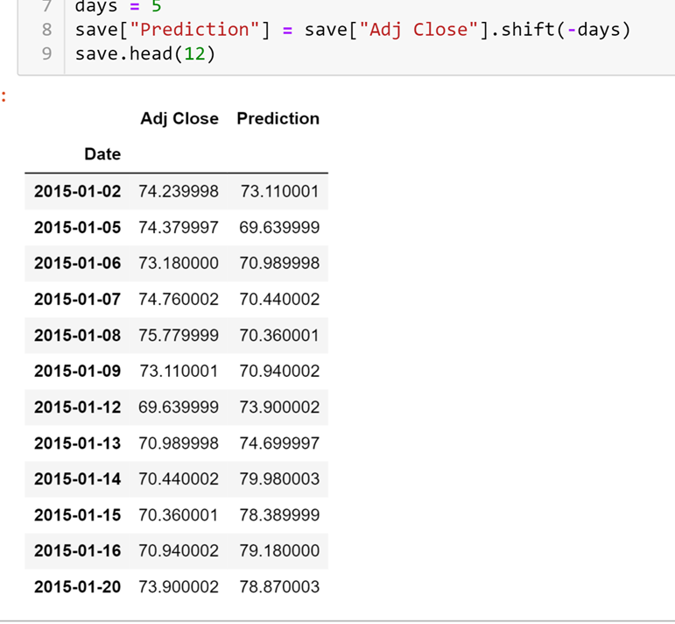
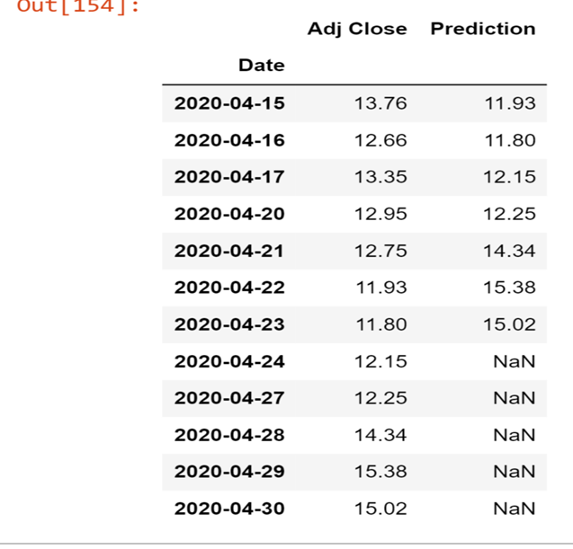
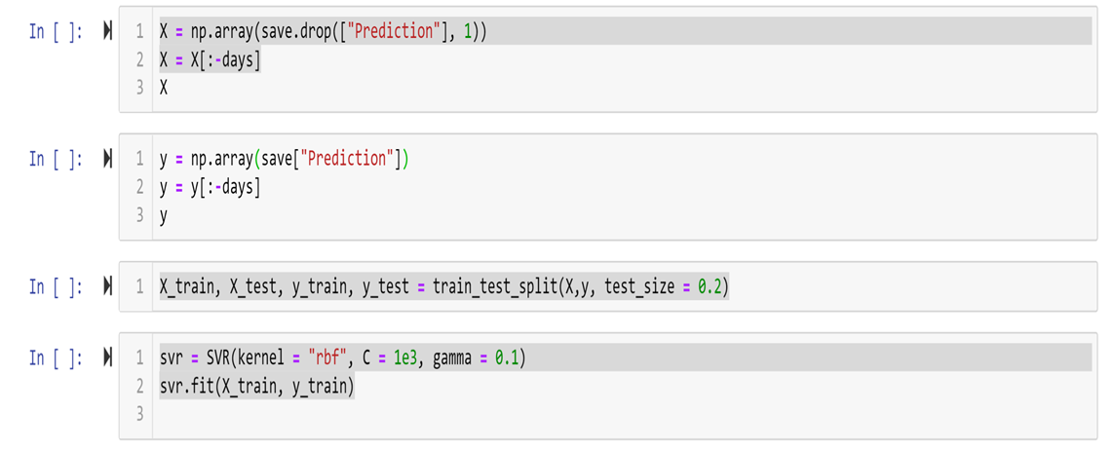
Support Vector Regression (SVR)
Number of days to predict
Adding a variable for number of days
Adding a new column by shifting
Fitting the Data
X & Y are the same size
Training the data on 20%
Fitting the data with the RBF kernel

Slide 11
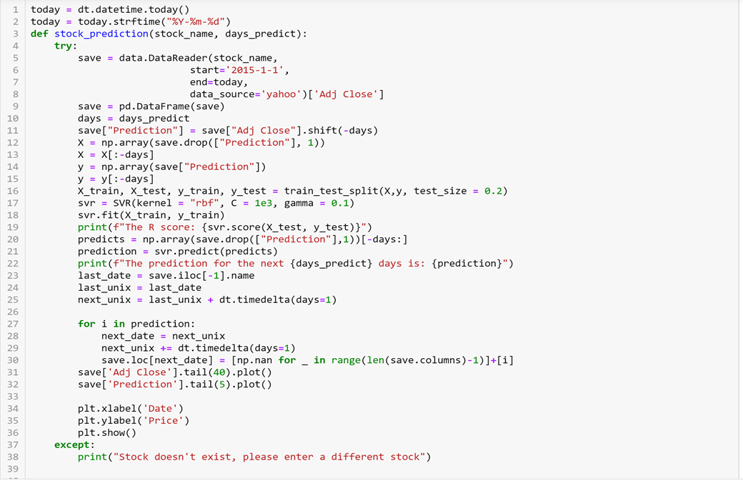
Support Vector Regression (SVR)
Creating a Function
Setting the end date to today
Choose the stock and the number of days
Catches error if you put a stock that doesn’t exist
Graphing

Slide 12

Thank you

